Slide 1
Youth under pressure
ENOC, September 2018
Notes:
It is a privilege to introduce you to the main results of our latest national panel survey among 8th grade students in Denmark.
In Denmark, mental health problems among children and young people has been increasing for years
In the Danish National Council for Children, we believe that studying children and young people's opinions and experiences are crucial when we are trying to understand and improve their living conditions.
That is why we have asked just over 4000 - and received the answers from 2615 young people in the 8th grade - corresponding to a response rate of 56 %. Further analyses indicates that the survey is representative of young people in public and private schools (the age of 14-15 years)
The purpose of the study was to gain an insight of the extent - and in what way - they feel like being under some sort of pressure. We have also asked them about their mental-, physical- and social health.

Slide 2
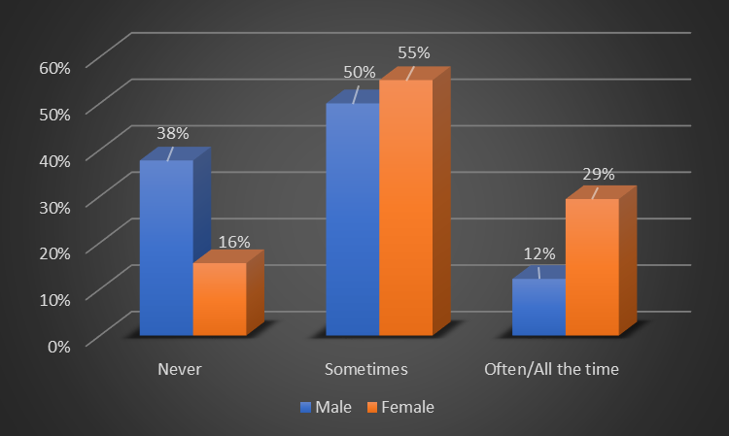
Do you ever feel like you are under pressure?
Notes:
In total, 74 pct. of the 8th graders say, that they feel under pressure either Sometimes, Often or All the time
Almost 1/3 of the girls feel under pressure Often or All the time!
For a few years now, students in 8th grade have been asked to choose their line of secondary educations. In 8th grade they are also subjected to a mandatory readiness assessment, to determine if they have the necessary academic, social and personal skills to pursue further education…
When we ask them in the questionnaire to describe, in their own words, the pressure they feel, the most common answers are related to decision making regarding their future education and a fear of not performing well enough academically and personally - in school as well as on the labour market and in society in general (a performance pressure)
When offered a range of possible answers - 61 pct. of the respondents point out that the pressure they encounter comes from school (30 pct. Points out that the pressure comes from themselves)

Slide 3
Think back on the most recent occasion when you felt under pressure. Describe why…
”Everybody expects you to do great. And you know if you don’t they get disappointed and you won’t be able to get an education”
”Whether I am able to live up to the requirements they have, so I’ll be able to attend the education I would like to.”
Notes:
To get a better insight of the kind of pressure these kids are under - and how they define the concept of pressure - the questionnaire offers the possibility of open answers, where they can type in whatever is on their mind, when answering the question:
Think back on the most recent occasion when you felt under pressure. Describe why…
Theese two quotes represent typical statements… Read!

Slide 4
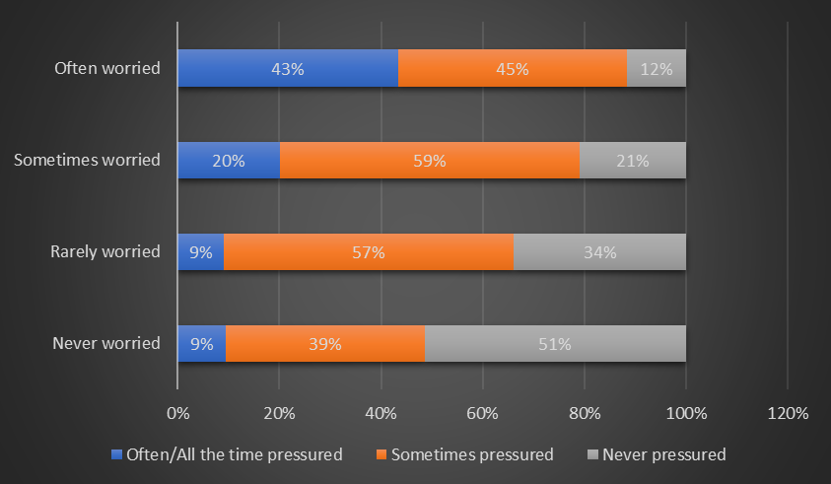
Notes:
In addition, we asked the 8th graders if they worry about the future:
The analysis indicates, that 41 pct. worry Sometimes, while 21 pct. worries about the future Often.
And there is a high correlation between how often they feel under pressure and how often they worry about the future.
As this chart shows, 43 % of those who worry Often, also feel pressured Often or All the time
Among those Never worried, only 9% feels pressured Often or All the time.
When we ask them: "What are you worried about?“ - 76% of their comments relate to education and their future work life!

Slide 5
What are you worried about?
”That I already have to decide what I want, which is a big thing to do when you are only in 8th grade. And I worry if I might make the wrong choice, whether I can achieve what I want after high school… for instance, if my grades are not good enough”
”How I am going to perform in relation to school and what is going to happen after I finish primary school and where to pursue my further education. There is just so much to consider I think”
Notes:
Two kids worrying, explains ….. Read!
The good future, and the good life, is inextricably linked to individual academic achievements within the educational system

Slide 6
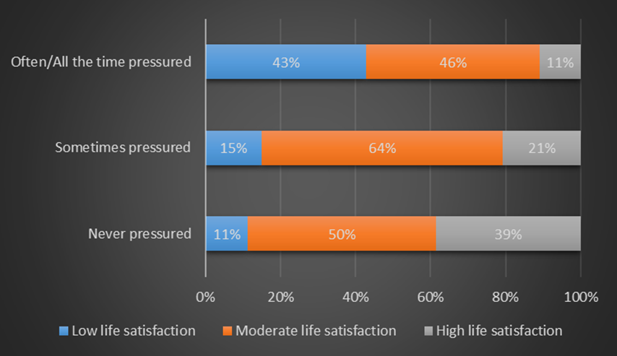
Correlation between perceived pressure and life satisfaction
Notes:
There is a strong correlation between the pressure these young people are subjected to and poor mental health (all the results presented here are highly significant)
This chart displays, how 43 % of those under pressure Often/All the time, are also categorized as having low life satisfaction
Compared to those respondents never pressured, the most pressured respondents, are far more likely to suffer from symptoms of poor mental, physical and social well being, e.g.:
Allmost one out of four respondents under pressure Often or All the time, are also categorised as lonely. Only one out of twenty respondents never under pressure are categorised as lonely!

Slide 7
Three respondents under pressure with low life satisfaction writes:
”I wish I wasn’t so sad all the time, and that I was able to accept my self”
”That I didn’t feel so pressured in relation to school as well as in my privat life. I wish almost everything was different”
”That I didn’t have to make decisions all the time and had the time to be a child for a little while longer and have fun”
Notes:
The final question in the questionnaire is open-ended: What would you like to be different in your life?
…Read!
The thing, that surprised us the most in this study is how many of these young people describes a fear of performing well enough – of not making it! - within the educational system, but also in relation to the labour marked and in society in generel.
They lack confidence in their own skills and personality - and they blame themselves, if they don’t always feel well and if they can’t always meet all requirements.
Many worry about their future: about meeting the necessary admission requirements or choosing the right education and career path. They worry about coping with the demands of society as a young adult. And they believe that academic achievements in school is the only admission ticket to the good life.

Slide 8
Notes:
Thank you for listening!

