Slide 1
Undertaking an independent Children's Rights Impact Assessment on COVID-19 policies
Presentation by Kay Tisdall, Childhood and Youth Studies Research Group, University of Edinburgh www.ed.ac.uk/education/childhood-and-youth-studies
Drawing on the work of the Observatory of Children's Human Rights Scotland www.ed.ac.uk/education/observatory

Slide 2
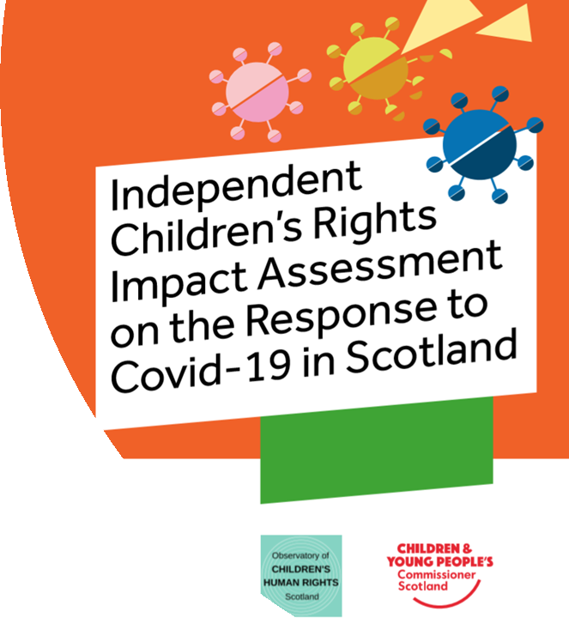
Aims of the Independent CRIA
Observe and document children and young people’s human rights issues in relation to legislation and policy, during the pandemic response, as they apply to children and young people in Scotland.
Anticipate issues and identify opportunities to embed children and young people’s human rights in ongoing developments in regard to developing law and policy.
Learn from the above, in terms of negative and positive implications for children and young people’s human rights during crisis situations.
https://cypcs.org.uk/coronavirus/independent-impact-assessment/

Slide 3
Process
Evidence
Children and young people's involvement
The whole of human rights

Slide 4
Conclusions
Making it meaningful and 'impactful'
Thinking about evidence and developing children's rights indicators
Expanding children and young people's involvement
The value of teams

