Slide 1
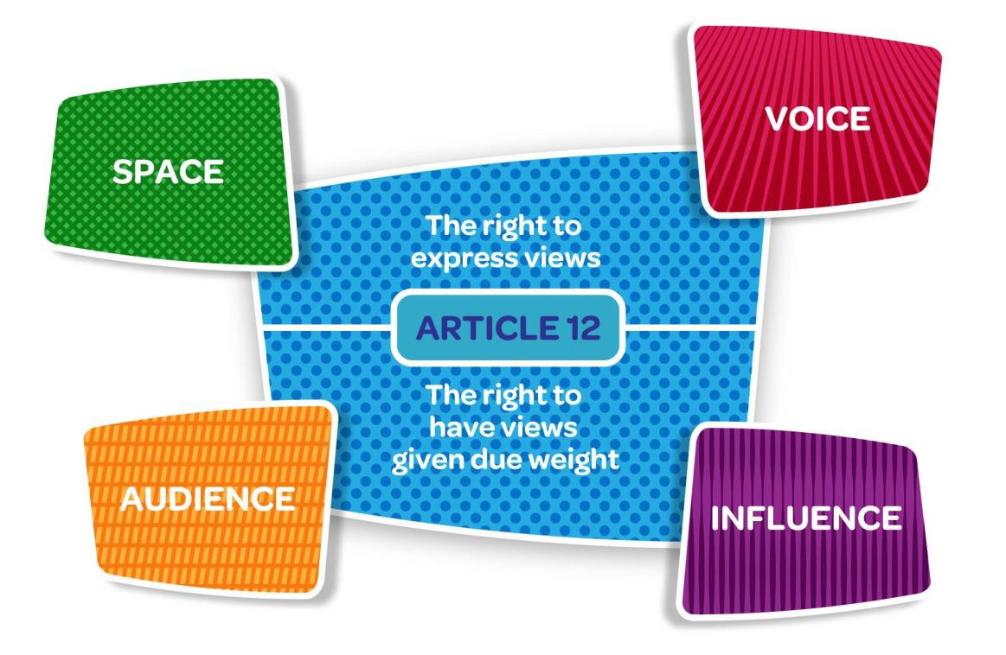
#OurBrexitToo
@OCO_Ireland
@NIChildCom
Notes:
We know what a Right to Participation is, but what does it look like in practice
What do we need to think about when we try to support children and young people to be able to fully realise their article 12 right?

Slide 2
Notes:
On 10th November last year OCO and NICCY jointly held an event for young people to share their views on how their rights could be affected by Brexit.

Slide 3
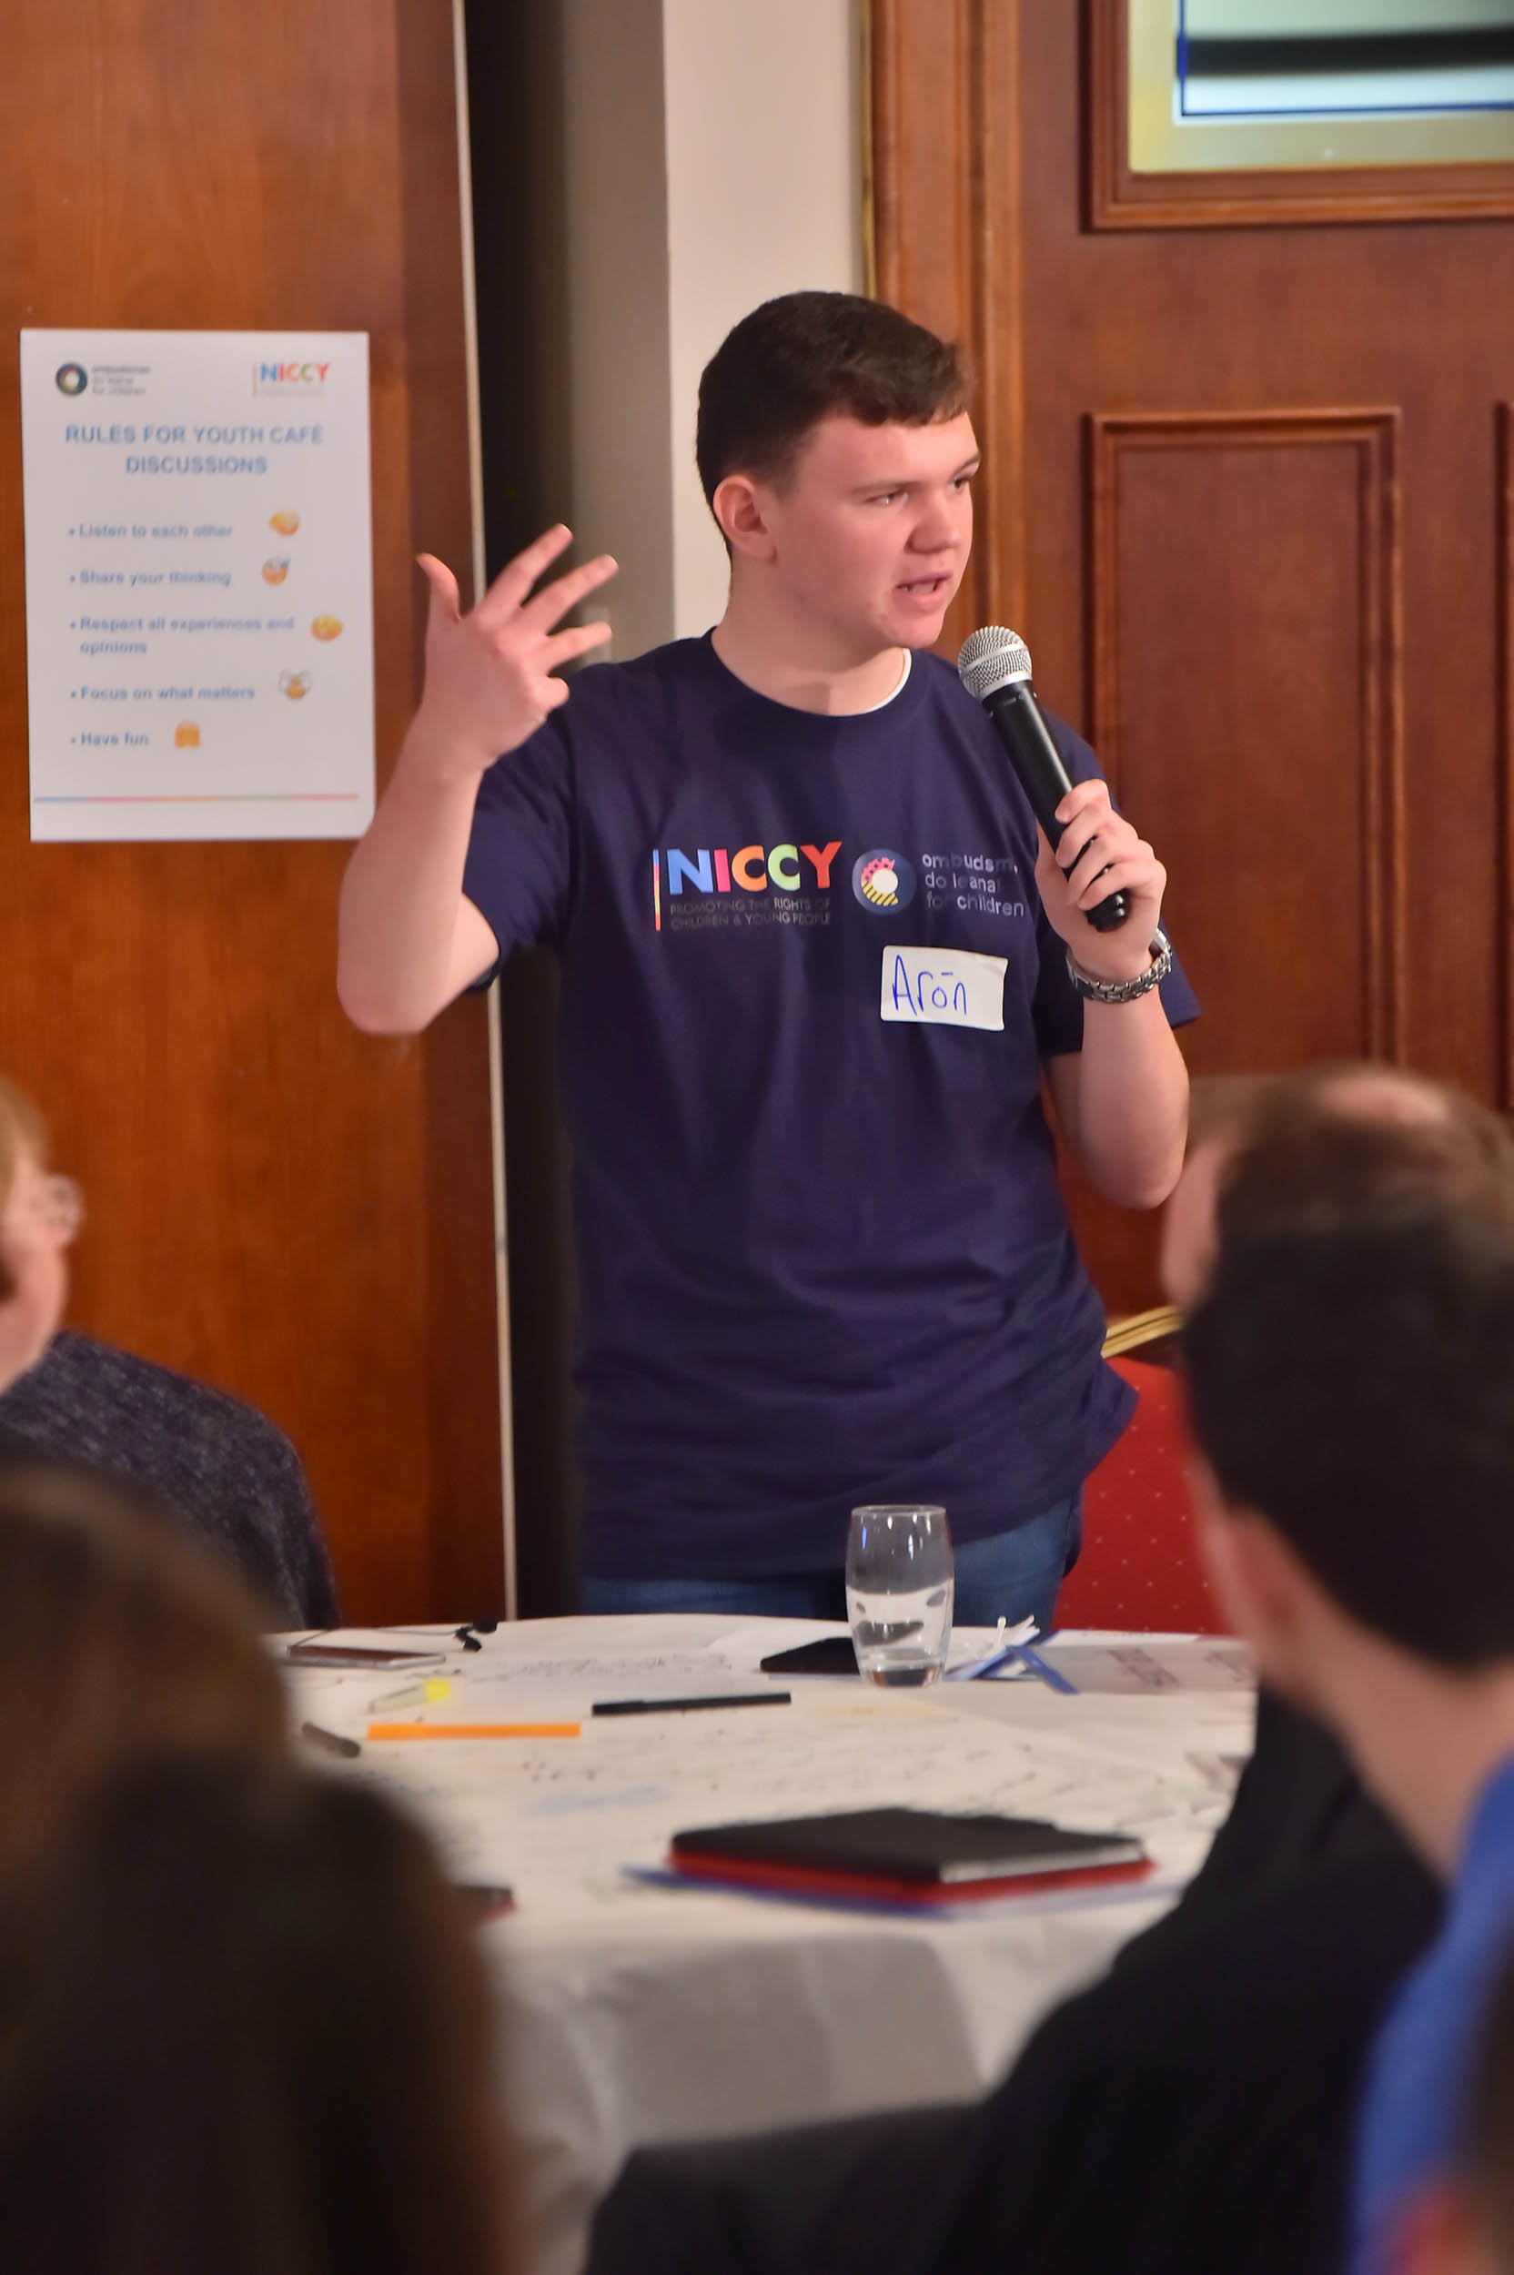
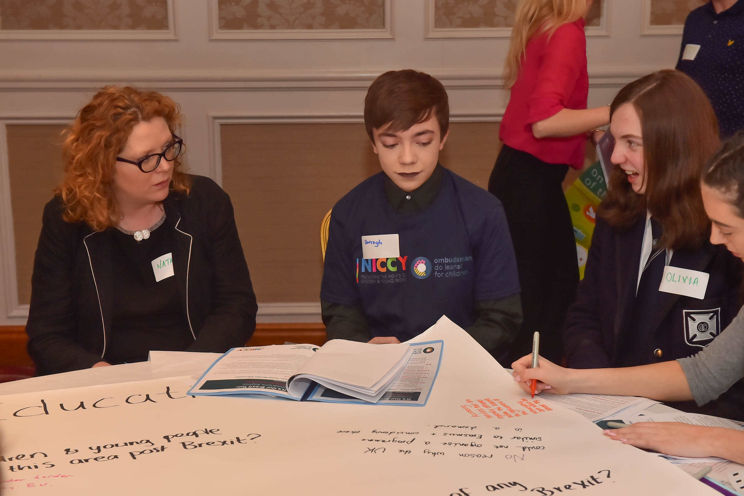
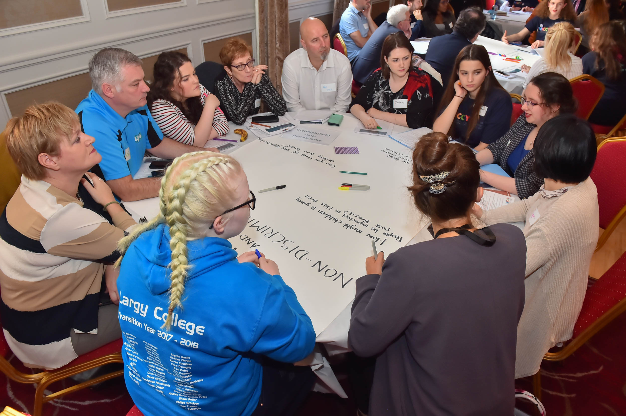
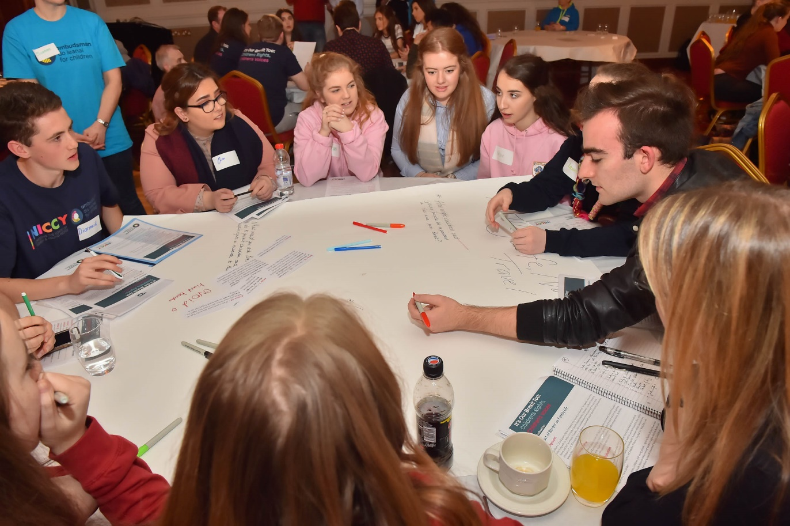
Notes:
What do you see here? Does it look like participation?
The Canal Court Hotel was full of around 120 young people expressing their opinions to decision makers.
But that’s just part of the story – so how did we get there and what have we done since?

Slide 4
Planning Phase
Agree scope of project
Engage relevant decision makers at an early stage
Be clear what we are asking of young people
#OurBrexitToo
@OCO_Ireland
@NIChildCom
Notes:
From the onset of planning we need to be clear about why we are asking young people to be involved and what we plan to do with the information.
There will be times that we have to impose parameters based on information we know eg Unionist politicians in NI will be difficult to engage
Agreed the following scope of the project
Parameters of discussion at event – eg not a border referendum debate and with the assumption that Brexit is happening
Ensure Children and Young People have a voice in Brexit negotiations
Ensure Children’s Rights inform the Brexit debate by both children and adults
Ensure Brexit does not have a negative impact on children’s rights on either side of the border
Identify positive opportunities arising from Brexit
We want to include an East-West dimension to be more inclusive of Unionists
The process had to be meaningful so we wanted to be clear on what we were asking of young people and confident that we could get decision makers to listen.

Slide 5
Planning Phase
Developing a youth led process
SPACE VOICE AUDIENCE INFLUENCE
Clear outline of what we were asking and offering
Parental consent and participant assent
Remove barriers to participation
Notes:
Its easier to create Space, Voice, Audience, Influence for their views within our own organisations but we were coming with some pre-determined parameters for the project so how do we ensure this is meaningful?
After working with the group we realised some aspects were just not viable (eg East-West dimension) so we took that on board
Some barriers such as cost and time are easy to deal with – others such
We couldn’t remove all barriers – ie limited timeframe meant

Slide 6
Planning Phase
Stages of group development
Developing an understanding of Rights and Brexit
Co-creative process
Notes:
When working with young advisors, no matter how experienced they are, we still need to pay attention to the normal group dynamics and stages of development
Group dynamics had to be addressed among our group to ensure all felt comfortable and safe to participate
The potential challenges brought up by Brexit are somewhat abstract and theoretical, some of the young people involved didn’t even have an understanding of children’s rights – add to that the particular complexities of politics in Northern Ireland.
There was a lot to get to grips with and at times young people just needed to step back from it and hand things back to – need to work jointly with young people when developing discussion guides for others coming to the event. Some had such an advanced understanding that we had to support them to pair back, for others we just needed to fact check a few things, others needed more input

Slide 7
Planning Phase
Addressing Challenges:
Addressing personal bias
Needs of young people as facilitators
Notes:
IMPORTANCE OF INCLUSIVITY AND DIVERSITY RATHER THAN NEUTRALITY AND BLINDNESS
Need to make sure young people are adequately prepared (guidance notes and rehersal)
Need for adult support at times eg child protection issues
Point to Laura Lundy

Slide 8
Event
SPACE VOICE AUDIENCE INFLUENCE
Advance preparation
Creating space for marginalised groups
Managing adults with a listening brief
Meaningful participation with a large group
Next steps
Notes:
Making sure other young people can engage fully in the process when we can’t guarantee they will be given support in advance to develop their views.
Creating space for marginalised groups to engage in the process – YOUTH CAFÉ PART OF PROCESS
Policing adults who are there with a listening brief – MARY EXAMPLE
Challenges of facilitating meaningful participation with a large group - SLIDO
Making sure participants understand next steps how we will feedback

Slide 9
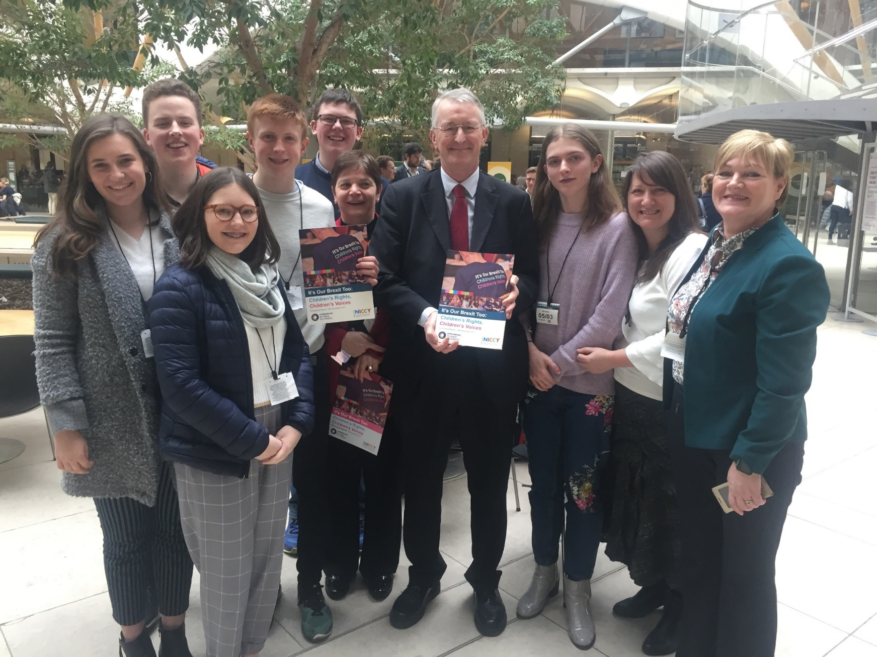
Notes:
Write up – check this reflected what they felt happened during discussions
Alex – TALK ABOUT PROCESS OF WRITING

Slide 10
Notes:
Dissemination visits to London, Brussels, All-Island Civic dialogue – CHALLENGES OF FOLLOW UP WITH DISPARATE GROUPS

Slide 11
Notes:
We had access to the right people and for many could get an audience but some of the people not interested in children’s rights they didn’t meet us
BARNIER EXAMPLE

Slide 12
Notes:
Next steps for NICCY and OCO - What is the role of ENOC in this process?

Slide 13
Guidelines for Youth Café • Listen to each other • Share your thinking • Respect all experiences and opinions • Focus on what matters • Have fun
#OurBrexitToo
@OCO_Ireland
@NIChildCom

Slide 14
Youth Café
Influencing influence:
How do we get disinterested decision makers to listen to children and young people and give their opinions due weight?
What role does ENOC have in protecting Children’s Rights after Brexit?

