Slide 1


ENOC Annual Conference - Day 1
Workshops
Protection Chair: Eduard Israyelyan, Human Rights Defender's Office, Armenia
‘Bee Secure’ – René Schlechter, Chair of the Ombuds-Committee for the Rights of the Child, Luxembourg
This Conference is co-funded by the European Union’s Rights, Equality and Citizenship Programme (REC 2014-2020)

Slide 2
BEE SECURE
Safer Internet Center for Luxembourg

Slide 3
Guidelines of the national cybersecurity strategy
Guideline No. 1: strengthening public confidence in the digital environment
    Objective 1 : Knowledge-sharing between all stakeholders
    Objective 2 : Disseminating information on risks
    Objective 3 : Raising awareness of all the parties concerned
    Objective 4 : Responsible disclosure
    Objective 5 : Combating cybercrime
Guideline No. 2: digital infrastructure protection
Guideline No. 3: promotion of the economy

Slide 4
BEE-SECURE
The initiative started in 2007 and has been operating under the BEE SECURE brand since 2010
BEE SECURE is funded by the European Commission and the Government.
BEE SECURE belongs to the European networks Insafe and INHOPE
BEE SECURE acts as Safer Internet Center for Luxembourg and benefits from European experiences of the said networks.

Slide 5
BEE SECURE is supported by
  Ministry of the Economy,
  Ministry of National Education, Children and Youth,
  Ministry of Family and Integration,
BEE SECURE is operated by
  Nationale Youth Service
  Kanner-Jugendtelefon (Child Helpline run by a consortium of 4 major NGOs )

Slide 6


Slide 7



Slide 8
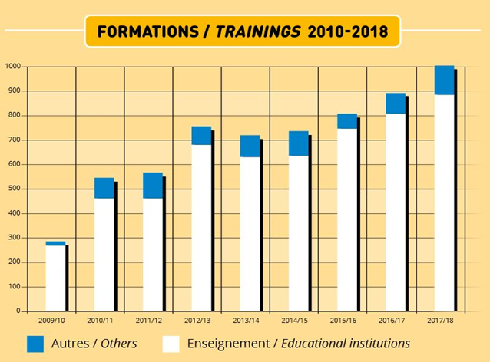

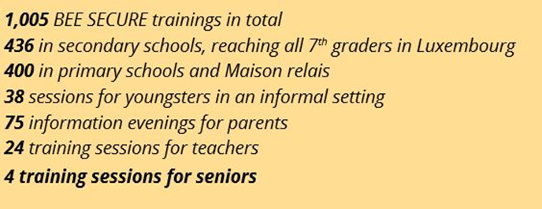

2018

Slide 9

Counselling and orientation via phone in all questions about safety online and the use of digital media
Confidential and anonymous
For all age groups
Tel.: 8002 1234 (free of charge)
Monday - Friday; 9am – 4pm
412 calls and 393 requests via the online contact form.
Main topics: E-crime, commercial risks and threats, technical settings, information about BEE SECURE training or events, privacy protection and cyberbullying

Slide 10
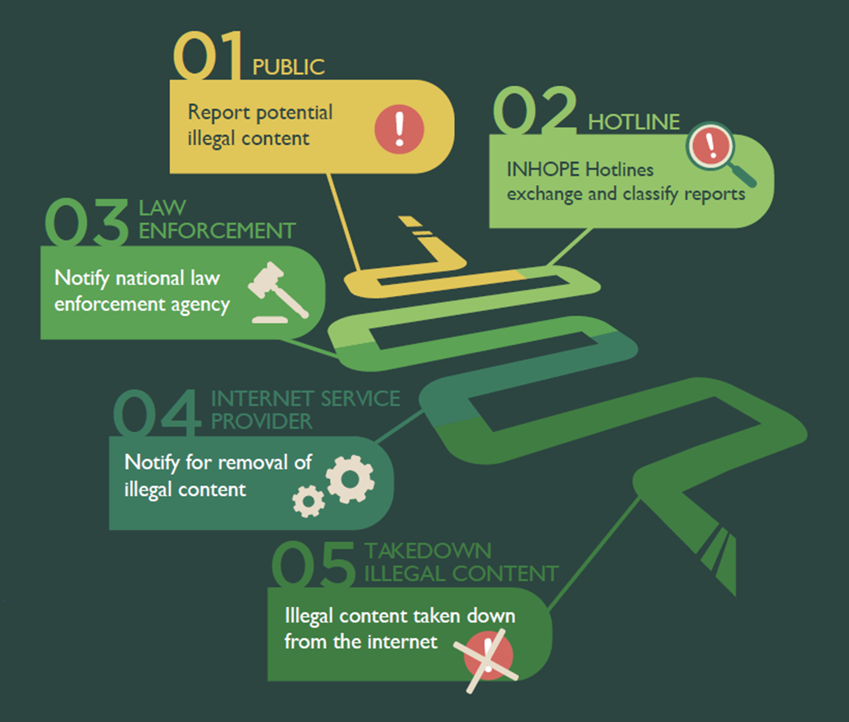

Report illegal content online in the context of:
  Child sexual abuse material (CSAM)
  Discrimination, Racism, Revisionism
  Terrorism
The Stopline registered
a total of 2,047 URLs containing content related to the sexual abuse of minors, 1,728 of which were classified as illegal by the BEE SECURE Stopline.
a total of 122 URLs containing racist, revisionist and discriminatory content, 68 of which were classified as illegal.
a total of 9 URLs containing terrorist content, of which 3 were classified as illegal.

Slide 11
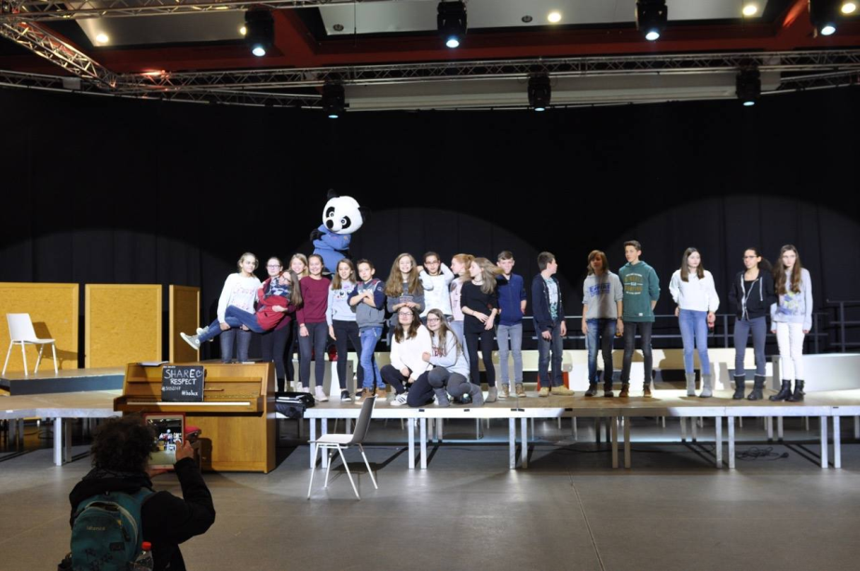
In order to keep up with the times and maintain direct contact with young people, BEE SECURE meets regularly with groups of children and young people for so-called "Kids Panels" or "Youth Panels" and also maintains an online group with young people, the "BEE SECURE Young Experts Team"

Slide 12

The annual thematic campaigns have a wide impact and long-term effect.
Each campaign has a clear message and covers a wide range of topics.
The campaigns are based on three objectives:
● Educating people in a positive way
● Creating a culture of safety
● Establishing a broader view of information safety

Slide 13
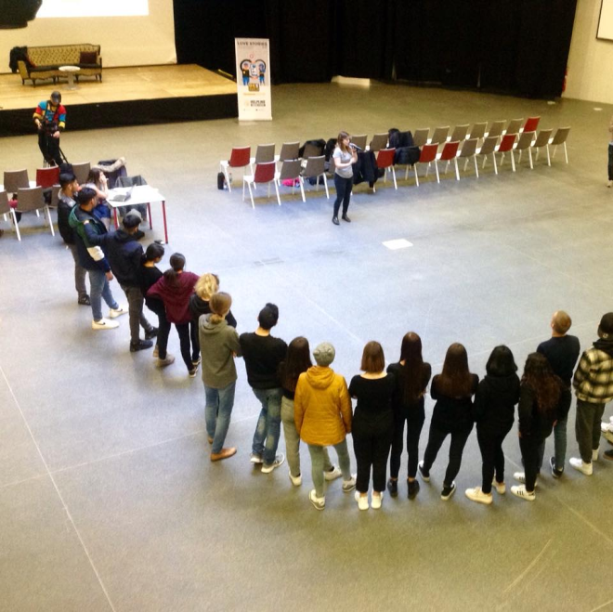
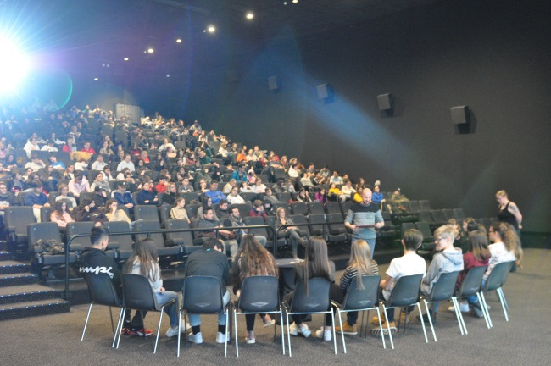
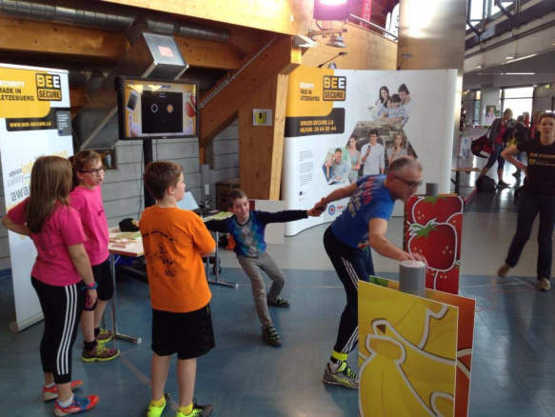
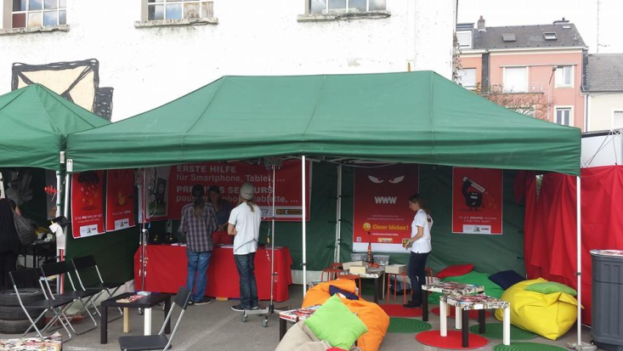
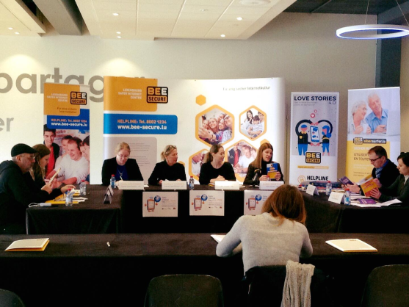

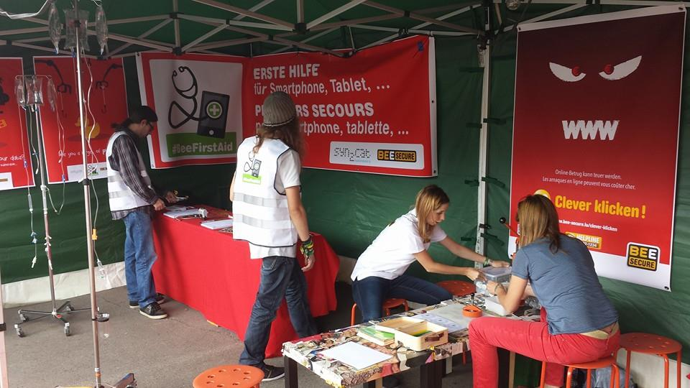
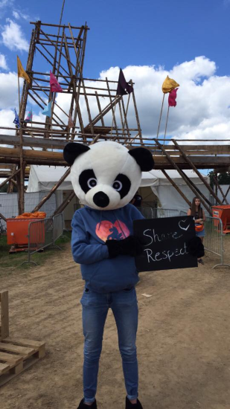
Events
BEE SECURE participates in numerous events throughout the year.
The primary objectives are to:
position BEE SECURE outside of schools and workplaces and
combine the message of online security with messages in other sectors.
More than 40 events were organized or
covered in 2018

Slide 14


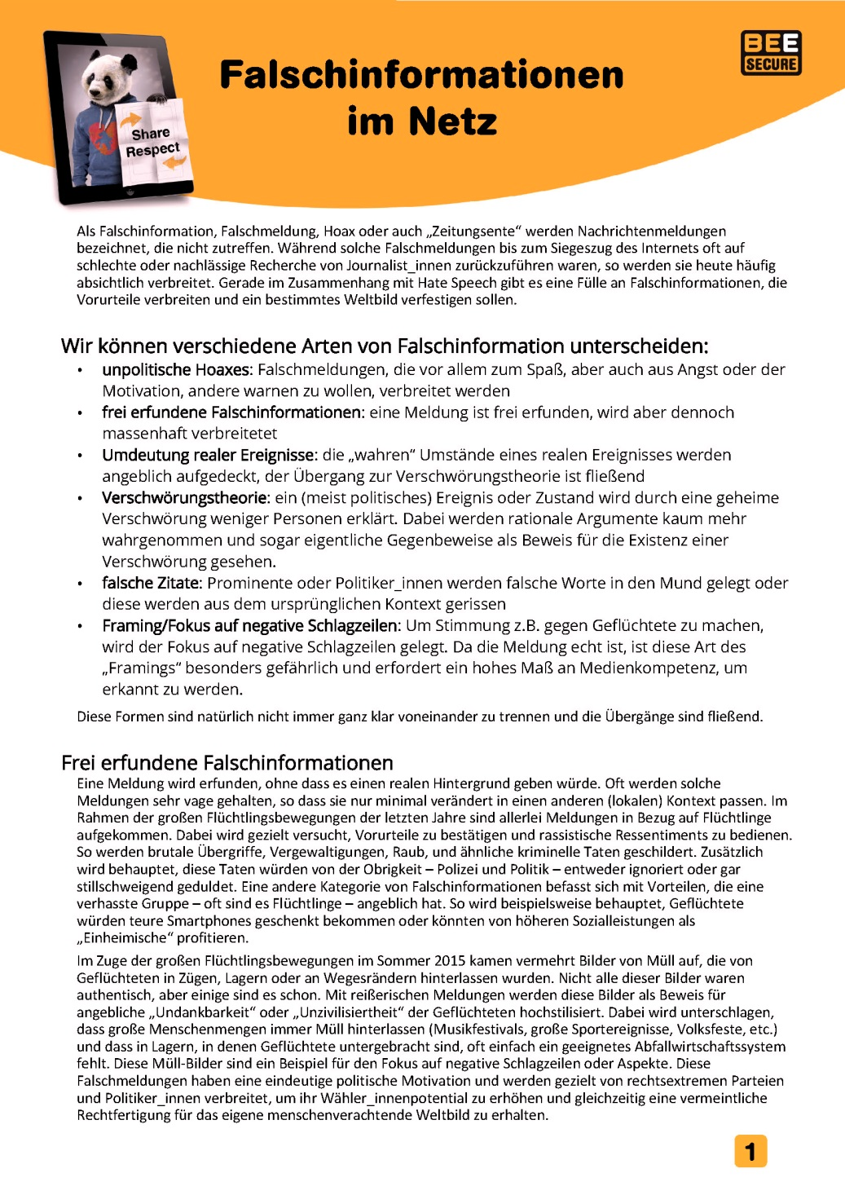


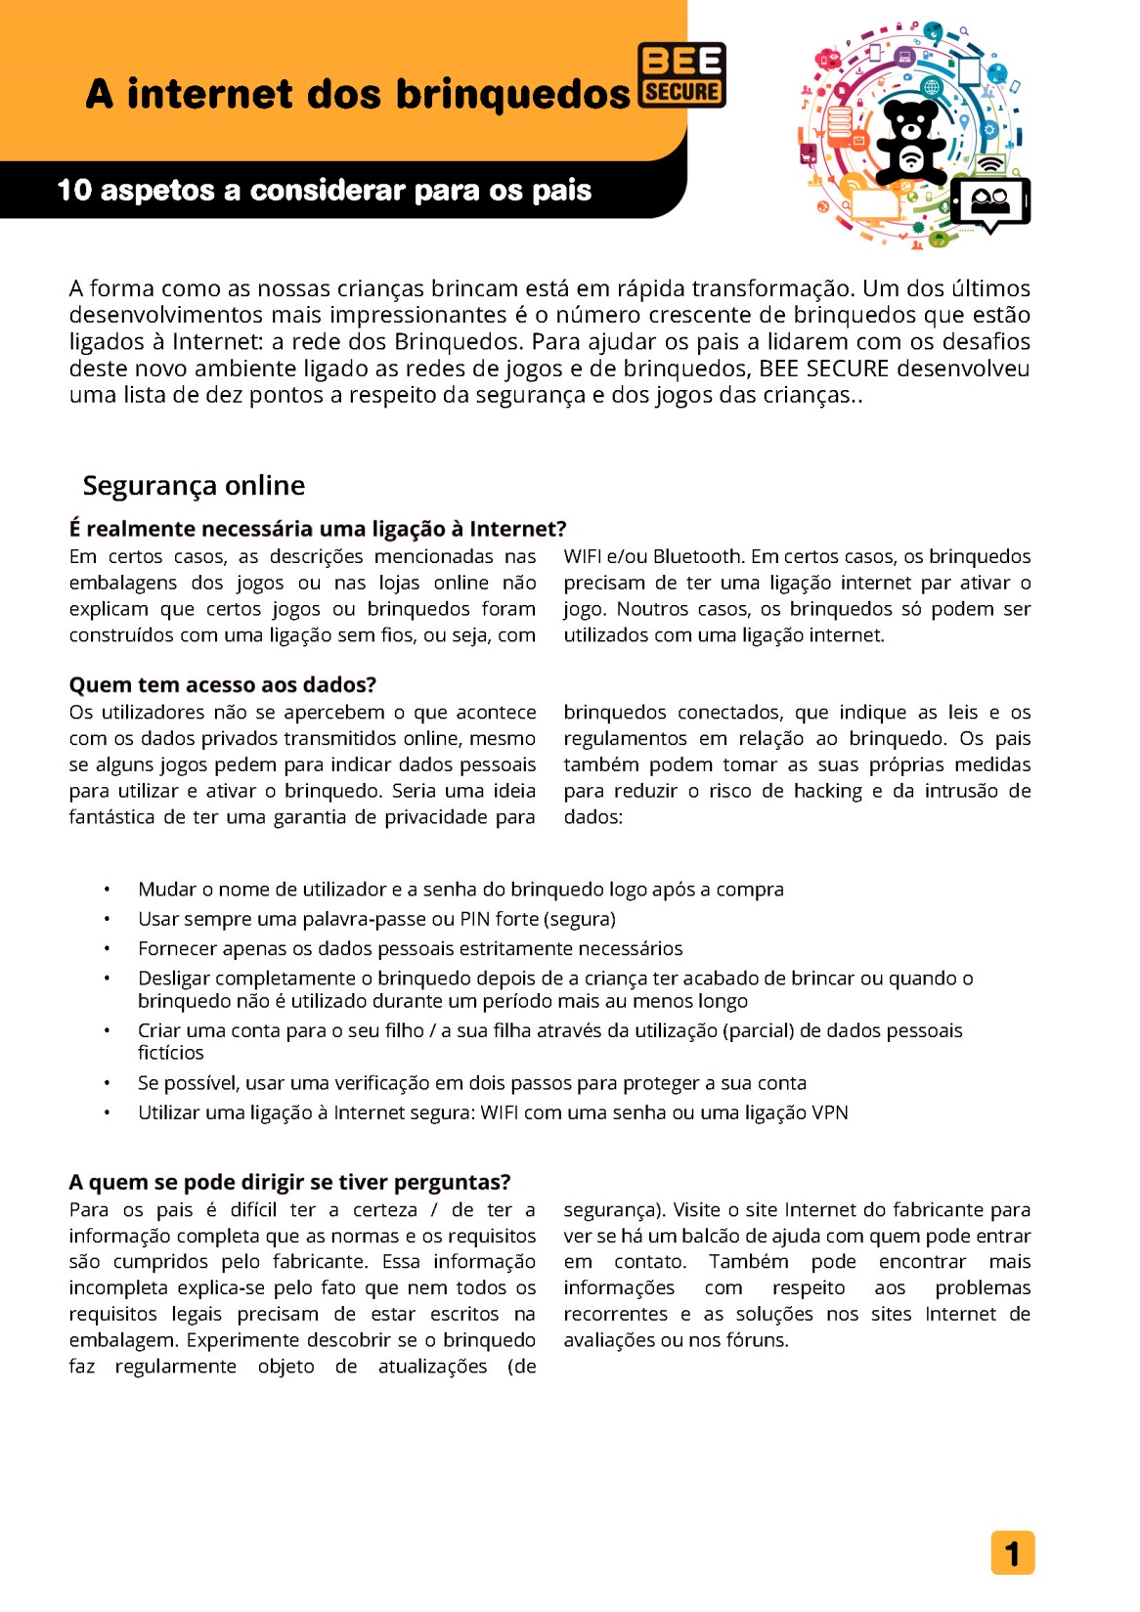
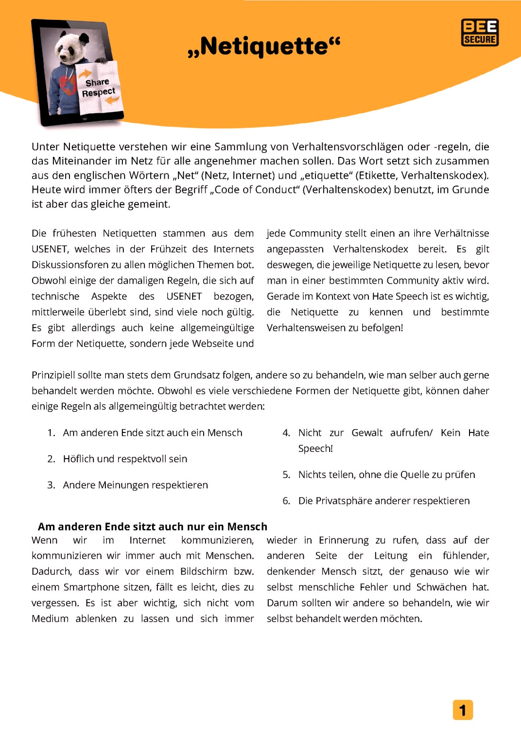

Tools

Slide 15
ADVISORY BOARD of BEE-SECURE
Afp-Services, Erzéiungs- a Familljeberodung
ANIJ – Agence Nationale de l’Information Jeunesse
Anonym Glécksspiller asbl
ASTI – Association de Soutien aux Travailleurs Immigrés Luxembourg asbl
ALIA – Autorité Luxembourgeoise Indépendante de l’Audiovisuel
CEC – Centre Européen des Consommateurs,
Luxembourg
CET – Centre pour l’Egalité de Traitement
CEPT – Centre de Prévention des Toxicomanies
CESAS – Centre national de référence pour la promotion de santé affective et sexuelle
CGJL – Conférence Générale de la Jeunesse du Luxembourg
Chambre des Métiers
Senioren-Secherheetsberoder
CNPD - Commission Nationale pour la Protection desDonnées
Conseil de Presse
ECPAT
Eltereschoul Janusz Korczak
ErwuesseBildung
FAPEL – Fédération des Association de Parents d’Elèves du Luxembourg
GovCert
Impuls – Service Thérapeutique Solidarité Jeunes
Level 2 – Hackerspace
Luxemburger Wort
Microsoft Luxembourg
Ministère de l’Éducation nationale, de l’Enfance et de la Jeunesse
Ministère de la Famille, de l’Intégration et à la Grande Région
Ministère de la Santé
Ministère de l’Economie et du Commerce extérieur - CASES
NorTIC
Ombudsman fir d’Rechter vum Kand
Parquet du Tribunal d’Arrondissement de Luxembourg
Police Grand Ducale
POST
RBS – Center fir Altersfroen
Respect.lu
RESTENA
RTL
SMC – Service des médias, des communications et du numérique
Technolink
ULC – Union luxembourgeoise des consommateurs
Université de Luxembourg
Young Caritas
Zentrum fir Politesch Bildung

Slide 16
Thanks!
René Schlechter
Ombudsman
for the Rights of the Child
rene.schlechter@ork.lu

Slide 17
ENOC Annual Conference - Day 1
Workshops
Protection Chair: Eduard Israyelyan, Human Rights Defender's Office, Armenia
Northern Ireland Online Safety Strategy – Eilís McDaniel, Director of Family & Children’s Policy, Department for Health, Northern Ireland
This Conference is co-funded by the European Union’s Rights, Equality and Citizenship Programme (REC 2014-2020)

