Slide 1
Children and Young People’s Participation in CRIA
Kjersti Botnan Larsen
kjersti@barneombudet.no

Slide 2
Topics
Results from the synthesis report about children’s participation
Challenges
Meaningful participation
How involve children in a CRIA process?
A Norwegian example
ENYA 2020 – what is happening
Lessons learned: Participation in the time of Covid-19

Slide 3
Key points from ENOC member survey
Identified challenges to implementing and improving CRIA practice in jurisdictions with a CRIA process in place included: [..]
There is no requirement to involve children and young people, and officials are unsure how to do so
When consultation with children and young people takes place, too often officials consult with the easy to find and easy to reach groups, neglecting younger children, harder to reach and more vulnerable groups
There are broader questions over how seriously children’s views are taken in the CRIA process.

Slide 4
Some challenges?
1) The adult’s lack of necessary knowledge and skills
2) Attitudes
- not understanding why children and YP’s participation should be a priority
3) Meaningful participation
– how to do it?

Slide 5
How? Results from the synthesis report about children’s participation
Key points from the research:
“The effectiveness of CRIA is dependent on certain elements of good practice being recognised and addressed in the development and delivery of the CRIA model in use. These include: […]
The meaningful involvement of children and young people in the CRIA process”

Slide 6
UNCRC art. 12 and GC no. 12
The right to be heard: a right of the individual child and a right of groups of children

Slide 7
D. Basic requirements for the implementation of the right of the child to be heard
“132. The Committee urges States parties to avoid tokenistic approaches, which limit children’s expression of views, or which allow children to be heard, but fail to give their views due weight. It emphasizes that adult manipulation of children, placing children in situations where they are told what they can say, or exposing children to risk of harm through participation are not ethical practices and cannot be understood as implementing article 12. “

Slide 8
Continue…
133. If participation is to be effective and meaningful, it needs to be understood as a process, not as an individual one-off event. Experience since the Convention on the Rights of the Child was adopted in 1989 has led to a broad consensus on the basic requirements which have to be reached for effective, ethical and meaningful implementation of article 12. The Committee recommends that States parties integrate these requirements into all legislative and other measures for the implementation of article 12.

Slide 9
Basic requirements which have to be reached for effective, ethical and meaningful implementation of article 12.
134. “All processes in which a child or children are heard and participate, must be”
Transparent and informative
Voluntary
Respectful
Relevant
Child-friendly
Inclusive
Supported by training
Safe and sensitive to risk
Accountable
Notes:
Different phases: Prepare – fasilitate– afterwoork

Slide 10
How do we facilitate the process in accordance with GC 12? Some key questions:
Does the matter affect children’s rights?
What children should be involved?
«all» children?, certain groups of children?
Those who are directly affected or those only indirectly?
When should we involve children/ let them have their say?
How should children be given the opportunity to participate?
Big or small groups of children? Alone?
Youth advisory groups? One time workshops? Interviews? Participatory methods?
Physically or digitally?
Who will talk to the young people?
Need for special training?
Who will be present?
Ex. entire public commissions?
How do we use the views of children and YP? What is due weight?

Slide 11
Good practice – an example from Norway - A new education act

Slide 12
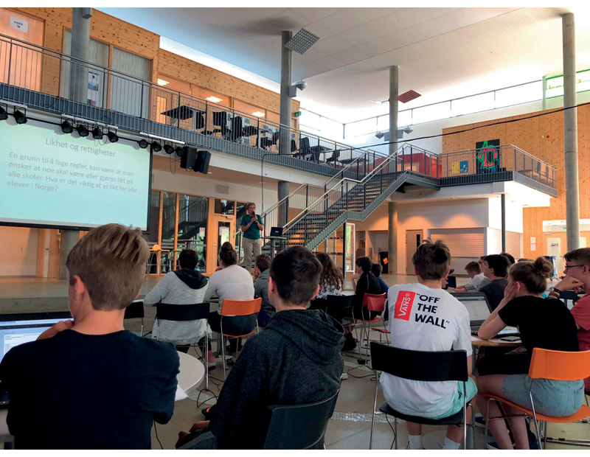
Principles for involving YP in the work
«The commission concluded at an early stage to follow these overall goals and principles for children and young people’s participation in our work […]:
A basic principle of the commission is that children and YP shall be heard when adults are heard.
School visits should be organized as part of the commissions meetings and travels, when possible.
Children and YP from approximately 10 years old should be heard. The commission strives to attain a certain representativity regarding age, gender, geography etc.
Formal channels like student councils and youth councils can be used, but also randomly chosen children and YP should be involved when it is possible and appropriate.
Stakeholders that are particularly relevant for different topics will be included where it is relevant.
A short, child friendly «translation» of the commissions mandate will be made.

Slide 13
Continue
A collection of standardized questions for children and YP shall be made.
The commission and the secretariat will hear children’s points of views themselves where it is possible, and will ask schools and municipalities for assistance to find children that wish to participate.
The Norwegian Ombudsperson for Children will be asked for assistance to conduct a workshop with children.
The entire commission shall be made particularly aware of input from children and YP
In the thematic notes that the commission uses as a knowledge base for their discussions, consequences for children and YP shall be a separate section
Children and YP’s views should be shown in as many chapter/ topics in the report as possible. The points of views should be commented by the commission in the biggest possible extent.”

Slide 14
Lessons learned
«In this chapter the commission has described it’s experiences with involving children and YP. In meetings and conversations the commission has experienced that the work the commission has done, has been noticed and appreciated.
At the same time the commission wish to emphasize that it has in no way been insurmountable or a hinder for the rest of the commissions work. On the contrary the commission acknowledge that the work that has been put down to involve children and YP, has contributed to making the road towards the final product easier, and the result better.»
Notes:
Section 4.5.
And go on calling for action from the government. More systematic involving of children and YP, need to be made gudielines for this.

Slide 15
ENYA 2020

Slide 16
ENYA 2020 – what is happening and what are we working on?
Topic 1 | Introduction to the topic: children’s rights and decision-making
Topic 2 | Children and young people’s participation
Topic 3 | LGBTIQ+ - a children’s rights question- consequences for decision-making
Topic 4 | CRIA and decision-making- advise from YP to adults and other YP
Recommendations on participation and good practice
Recommendations on LGBTIQ+ rights
Recommendations on CRIA and how children’s rights can be better respected, protected and fulfilled in decision-making with advice for both young people and adults

Slide 17
Lessons learned? Participation in the time of Covid-19

Slide 18
Some challenges?
Many countries have and will for a long time have restrictions that affects how children can . This will also be a problem for those undertaking CRIAs.
Restrictions on physical meetings – allowed?
Social distancing – 1 or 2 meters apart?
Parents might be concerned about the infection risk
Children from vulernable groups with high infection risk
Moving things to digital arenas
Facilitatators may lack the knowlede and tools to do it.
Children are fed up with digital meetings?
Should this be the easy way out for those not wishing to involve children? Or do we adapt our way of thinking?

Slide 19
Lessons learned?
Have to think differently:
Preparing for a digital meeting
You just can’t do the same things online – have to adapt it to the digital sphere.
Safeguarding issues when you are dealing with sensitive topics?
Access and the quality of the connection.
One device per person works best, but not everyone might have that? Poverty? Can disqualify important voices.
Letting everyone’s voice be heard? How?
Written or oral? Use of chat function? Polls?
Use of plenary sessions? Break out groups?
Size of break out groups? Smaller then IRL
Can have more meeting of a shorter length.
Easier to find time for a meeting when there is no travel.
For some it works better.
More comfortable online, physical barriers are less.
The adult role might be different?

Slide 20
Continue
Onboarding
Making them comfortable? Feel safe?
Newcomers?
Icebreakers?
Create a safe environment
Social arenas?
Codes of conduct in digital meetings?
Camera on? off?
«Zoom-fatique»?
Participatory methods
Smaller work packages – «mini-methods»
What programs/ tools?
Different functions in zoom: polls, Q & A, black board
KAHOOT, Menti
Escape rooms (Google Forms? Fortnite?)
Word?
Other? Padlet Mural
Documentation – what has been disgussed?
Evaluation with the YP – what worked and not?

Slide 21
Notes:
This is Padlet

Slide 22
Notes:
This is mural

Slide 23
Topics
Results from the synthesis report about children’s participation
Challenges
Meaningful participation
How involve children in a CRIA process?
A Norwegian example
ENYA 2020 – what is happening
Lessons learned: Participation in the time of Covid-19
Notes:
Need to lift the good ex.

