Slide 1
Learning about and supporting children’s mental health during the pandemic:
A Children’s Commissioner's role
Sally Holland
Comisiynydd Plant Cymru
Children’s Commissioner for Wales

Slide 2
Our Main Aims During the Pandemic
Make sure children have clear and reliable information and advice
Check that children are safe and getting what they need
Make sure children are listened to
Help government and other services hear and respond to children's experiences and views

Slide 3
What have children in Wales told us about how they have been feeling during the pandemic?

Slide 4
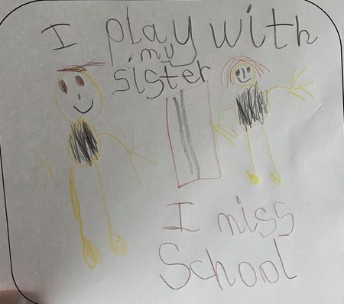
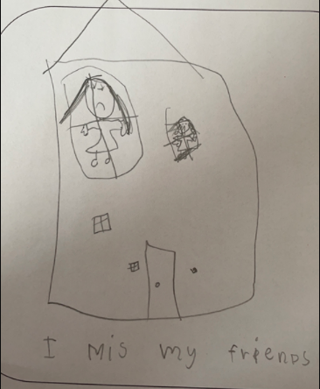

Slide 6
I hate this pandemic, and I hate locking down. I want to train football with my friends, go for walks with my family and gather with friends and have fun. Boring (10 year old mid Wales)
I feel really angry and frustrated that nearly a year of my childhood has been lost. I love and thrive in going to school and the total lack of any structure and routines is really affecting me now. I have put on weight as i can't even play football which i love. I'm really sociable and haven't seen friends for months and have no idea when i will again. Every day is the same and i feel quite hopeless (15 year old south east Wales)

Slide 7
I am enjoying lockdown more than school and am much less stressed than I used to be (13 year old central south Wales)
Not going to school has helped me in many ways; it gave me time to recover from being in poor mental health and gave me a break from all the hassle of school days (13 year old, north west Wales)
I’ve gotten closer to my family because they used to be out all the time, now they are at home and I talk to them more (15 year old south east Wales)

Slide 8
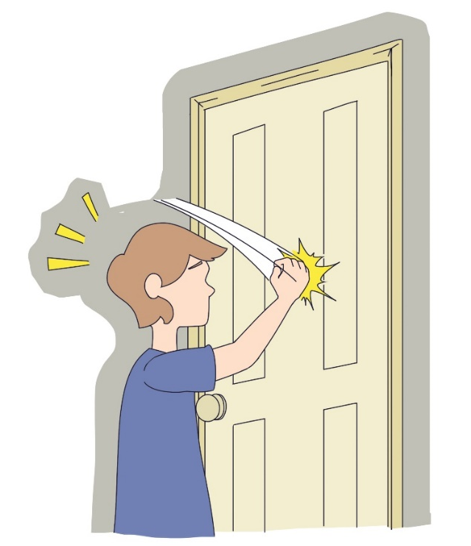
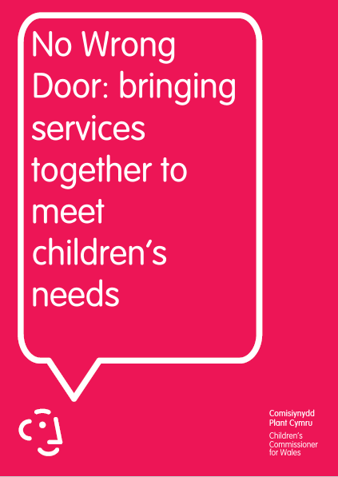
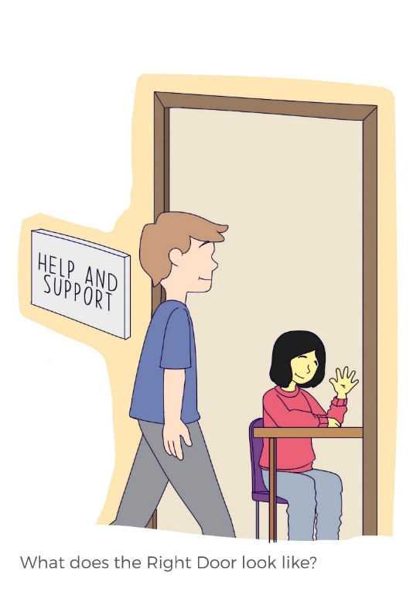
No Wrong Door

